Slide 1
Building and Operating modern .NET Core applications as microservices in containers
Damir Dobric
daenet CEO, Lead Architect
Microsoft Regional Director
Azure Most Valuable Professional
https://damirdobric.me

Slide 2
Agenda
Evolution of compute platform
Docker Containers
Running .NET Core in docker
Azure Container Registry
Azure Container Instances
Orchestrators
K8
Service Fabric
Container Apps

Slide 3
Evolution
VMs
Containers
Orchestrators
PaaS
Serverless

Slide 4
VM
Virtualization of everything running on OS

Slide 5
Container | MOBI | Docker
Virtualization of a single application
https://www.youtube.com/watch?v=vmnvOITMoIg

Slide 6
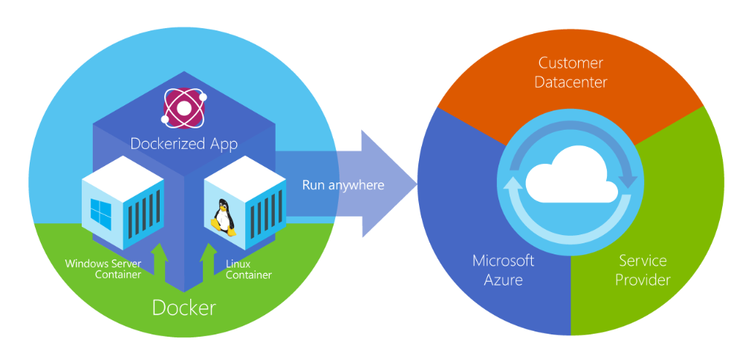
What is “Docker”?
Docker is an open-source project for automating the deployment of applications as portable, self-sufficient containers that can run on the cloud or on-premises. Docker is also a company that promotes and evolves this technology, working in collaboration with cloud, Linux, and Windows vendors, including Microsoft.
Was ist Docker? | Microsoft Docs

Slide 7
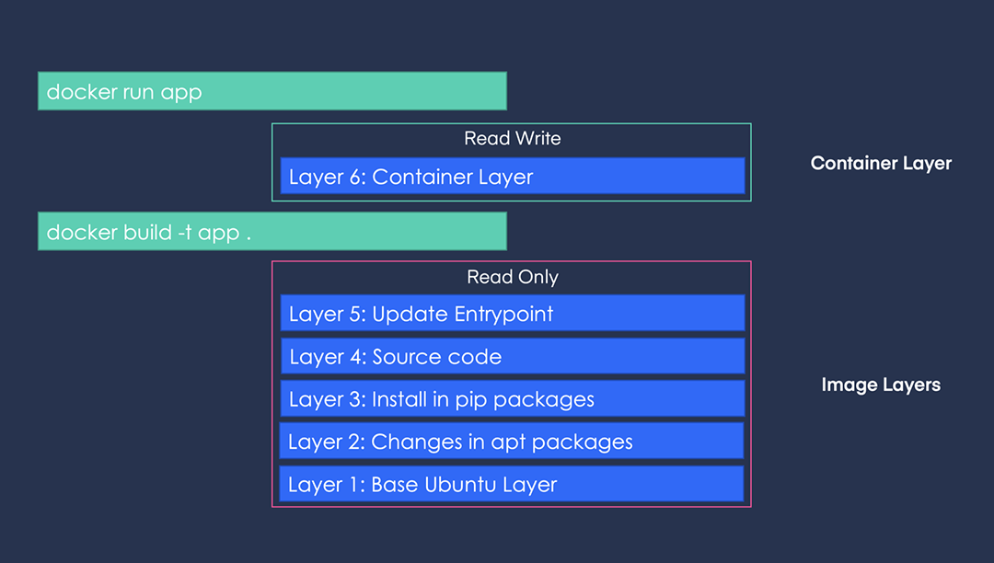
Layers

Slide 8
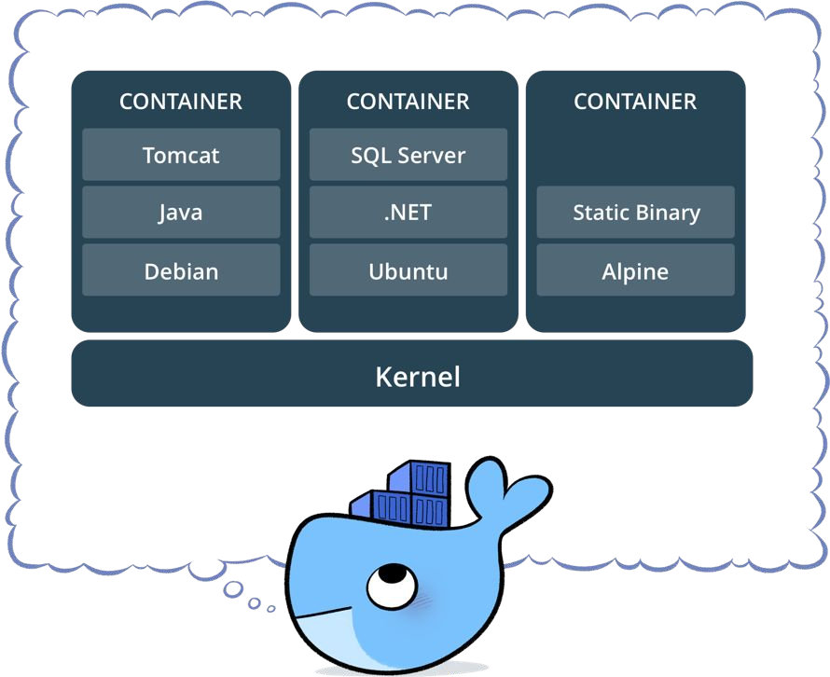
Docker packaging
Standardized packaging for software and dependencies
Isolate apps from each other
Share the same OS kernel
Works for all major Linux distributions
Containers also native to Windows
Cloud Computing – Frankfurt University of Applied Sciences

Slide 9
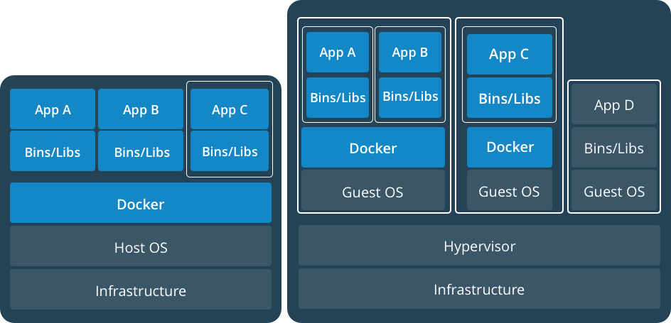
Application virtualization
Cloud Computing – Frankfurt University of Applied Sciences

Slide 10
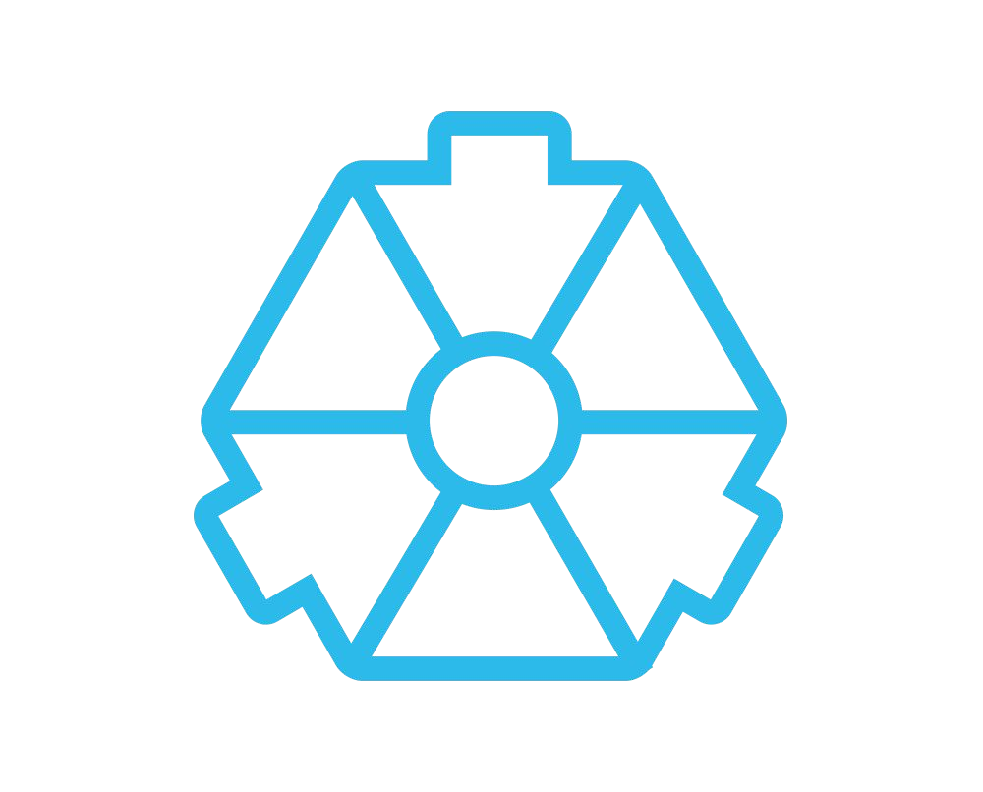

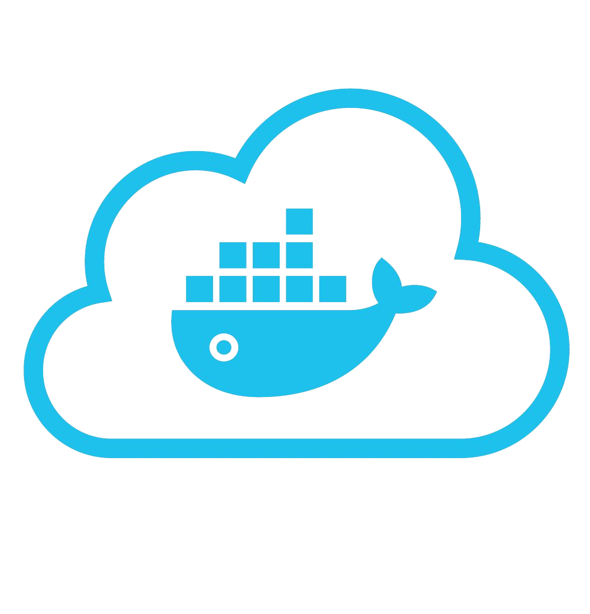




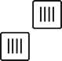




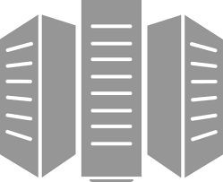
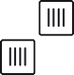


Packaging, publishing and running - DevOps
Developers IT Operations
BUILD
Development Environments
PUSH
Registry
RUN
VM,ACI, Kubernetes,..
Repositories
10
Cloud Computing – Frankfurt University of Applied Sciences

Slide 11
Docker Vocabulary
Docker Image
The basis of a Docker container. Represents a full application
Docker Container
The standard unit in which the application service resides and executes
Docker Engine
Creates, ships and runs Docker containers deployable on a physical or virtual, host locally, in a datacenter or cloud service provider
Registry Service
Cloud or server based storage and distribution service for your images
Docker Hub(Public), Docker Trusted Registry(Private),
Azure Container Instances (public or private),
On-Prem (your own)
Cloud Computing – Frankfurt University of Applied Sciences

Slide 12
Basic commands
$ docker image pull node:latest
$ docker image ls
$ docker container run –d –p 5000:5000 –-name node node:latest
$ docker container ps
$ docker container stop node(or <container id>)
$ docker container rm node (or <container id>)
$ docker image rmi (or <image id>)
$ docker build –t node:2.0 .
$ docker image push node:2.0
$ docker --help
Cloud Computing – Frankfurt University of Applied Sciences

Slide 13


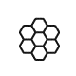
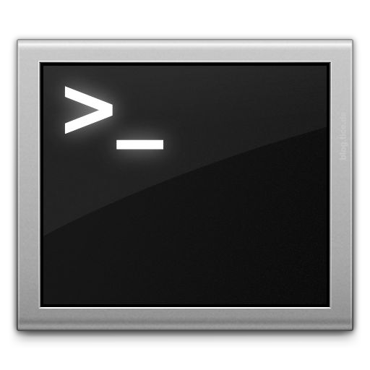
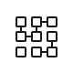







Compose, Microservices
Build and run one container at a time
Manually connect containers together
Must be careful with dependencies and start up order
Define multi container app in compose.yml file
Single command to deploy entire app
Handles container dependencies
Works with Docker Swarm, Networking, Volumes, Universal Control Plane
Cloud Computing – Frankfurt University of Applied Sciences

Slide 14
Docker Containers
VMs
Containers
Orchestrators
PaaS
Serverless
Cloud Computing – Frankfurt University of Applied Sciences

Slide 15
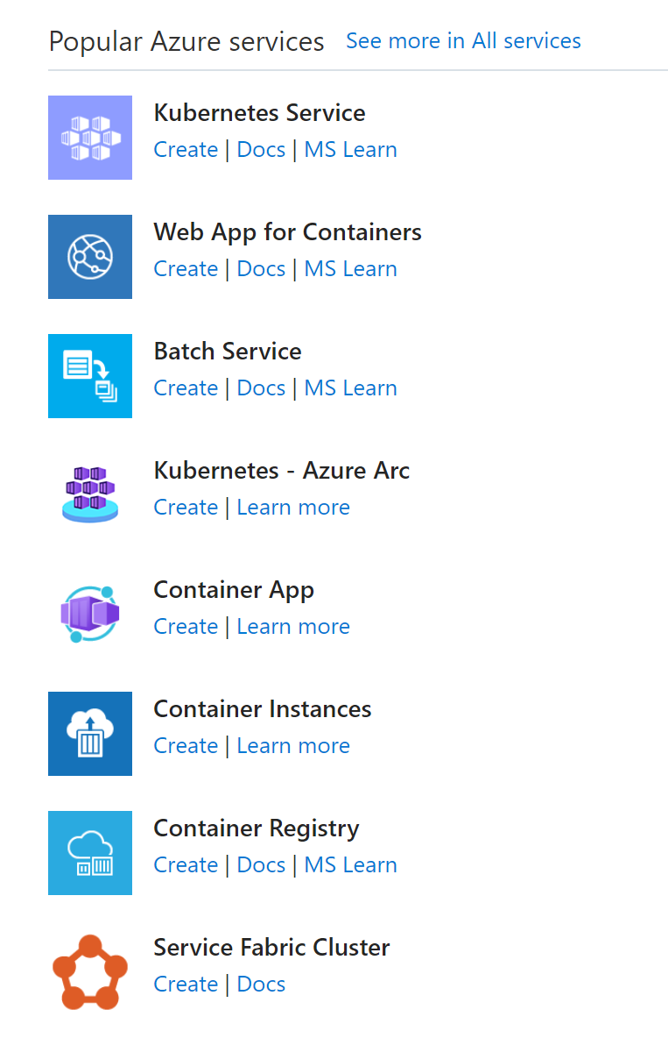
Containers in Azure

Slide 16
Exercises
Deploy existing image and run it locally
Customize a Docker image to run your own web app
Build conainerized web application to run in cloud
Cloud Computing – Frankfurt University of Applied Sciences

Slide 17
Running .NET Core in Docker container
https://developers.de/2019/04/17/fastest-way-to-build-net-core-app-docker-image/
Cloud Computing – Frankfurt University of Applied Sciences

Slide 18
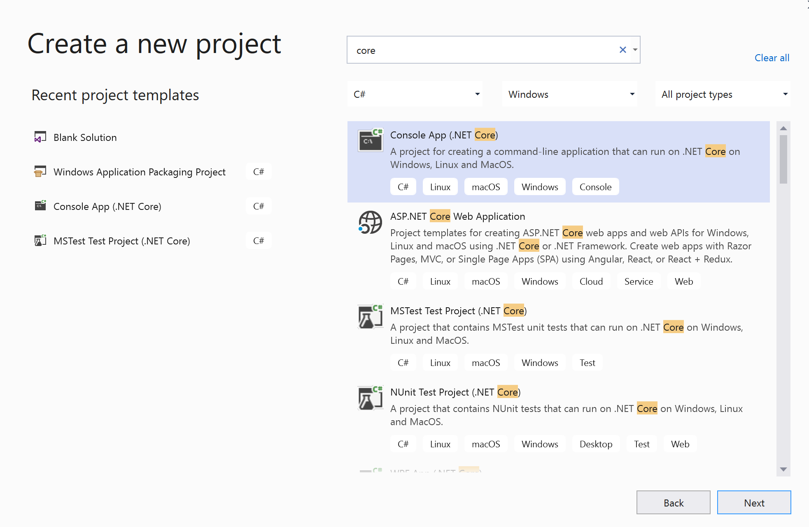

Slide 19
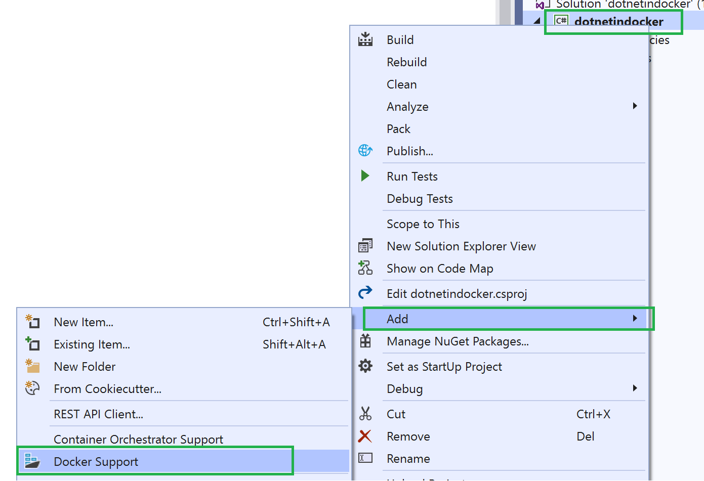
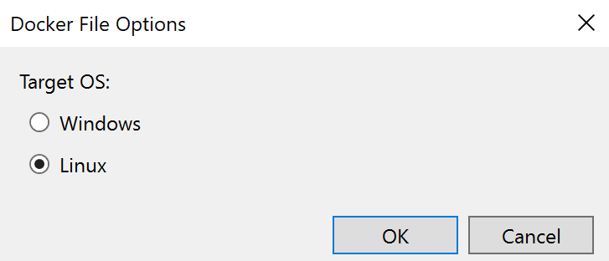
Create .NET App in container (I)
static void Main(string[] args)
{
int n = 100;
while (--n > 0)
{
Console.WriteLine("Hello World!");
Thread.Sleep(1000);
}
}

Slide 20
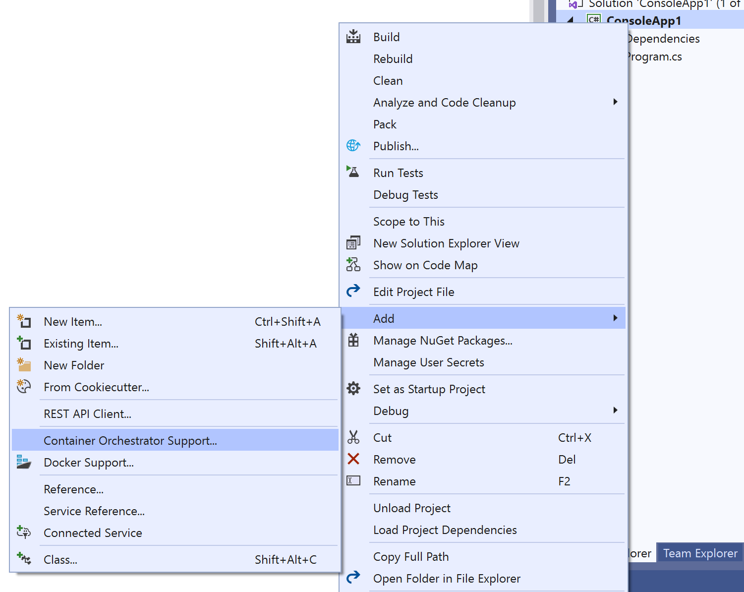
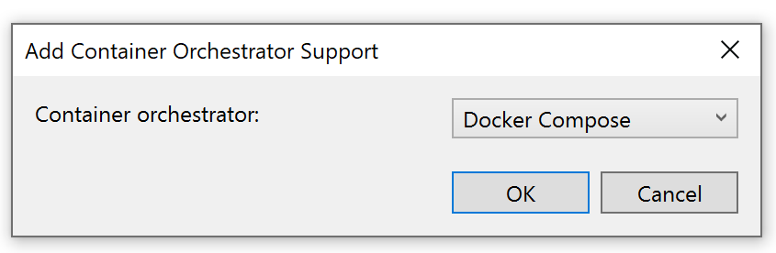
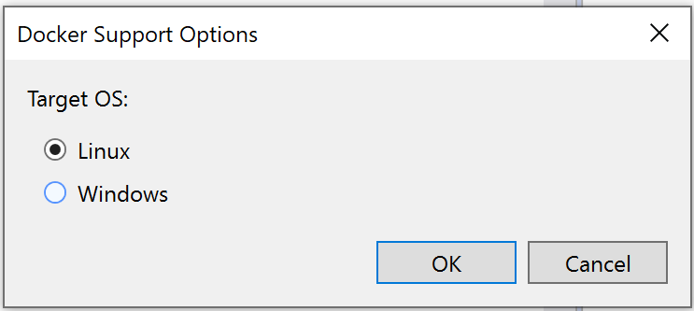
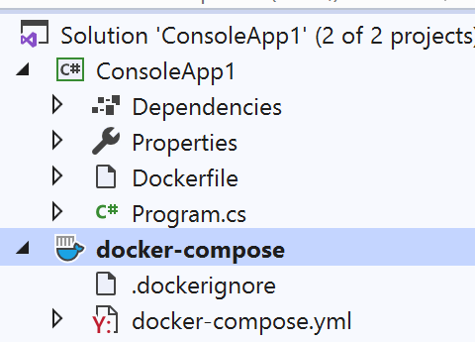
Create .NET App in container (II)
static void Main(string[] args)
{
int n = 100;
while (--n > 0)
{
Console.WriteLine("Hello World!");
Thread.Sleep(1000);
}
}

Slide 21
Dockerfile of .NET Core Application
FROM mcr.microsoft.com/dotnet/core/runtime:3.0-buster-slim AS base
WORKDIR /app
FROM mcr.microsoft.com/dotnet/core/sdk:3.0-buster AS build
WORKDIR /src
COPY ["DockerConsole.csproj", ""]
RUN dotnet restore "./DockerConsole.csproj"
COPY . .
WORKDIR "/src/."
RUN dotnet build "DockerConsole.csproj" -c Release -o /app/build
FROM build AS publish
RUN dotnet publish "DockerConsole.csproj" -c Release -o /app/publish
FROM base AS final
WORKDIR /app
COPY --from=publish /app/publish .
ENTRYPOINT ["dotnet", "DockerConsole.dll"]

Slide 22
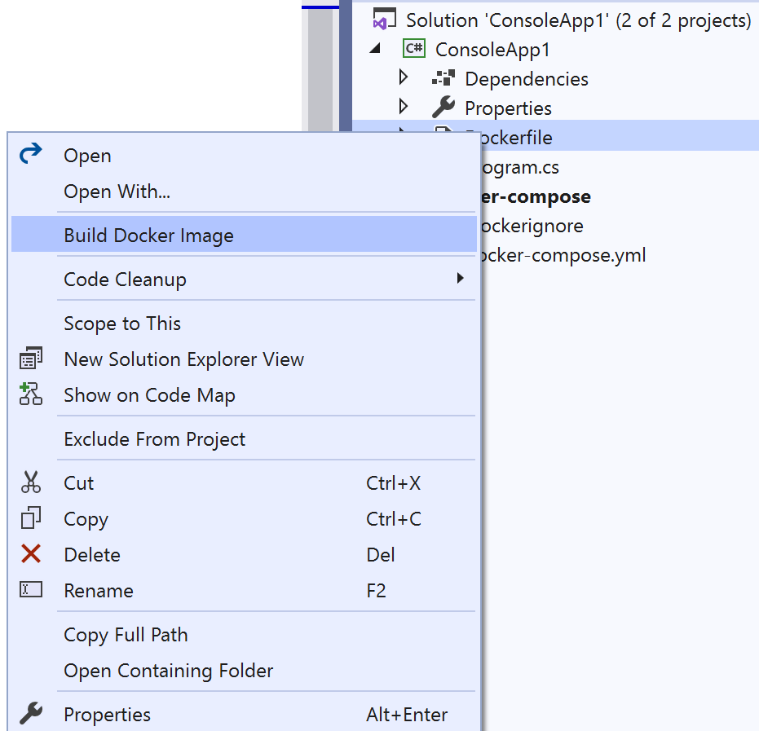
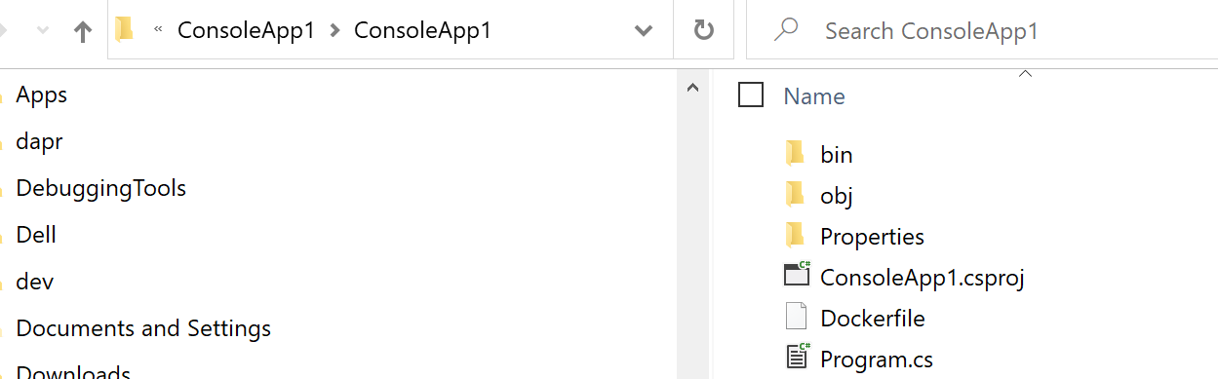
Build image
C:\temp\ConsoleApp1> docker build --rm -f “ConsoleApp1/dockerfile" -t dockerconsole:v1 .

Slide 23
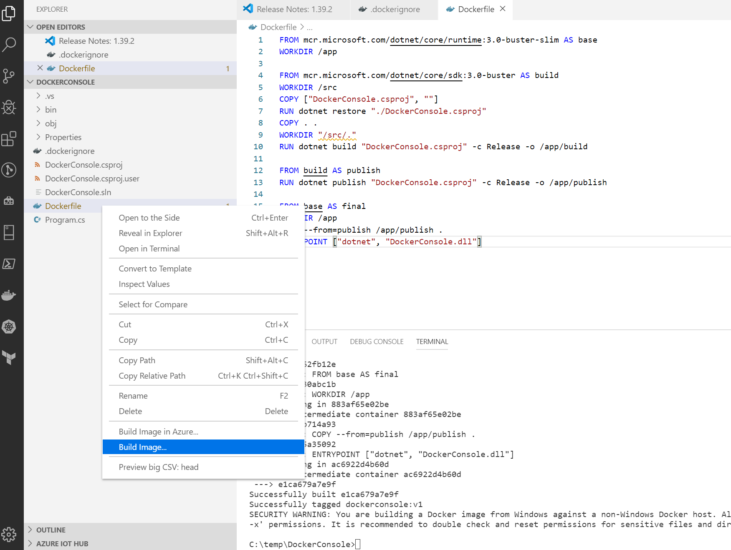
Build Image in VS Code

Slide 24
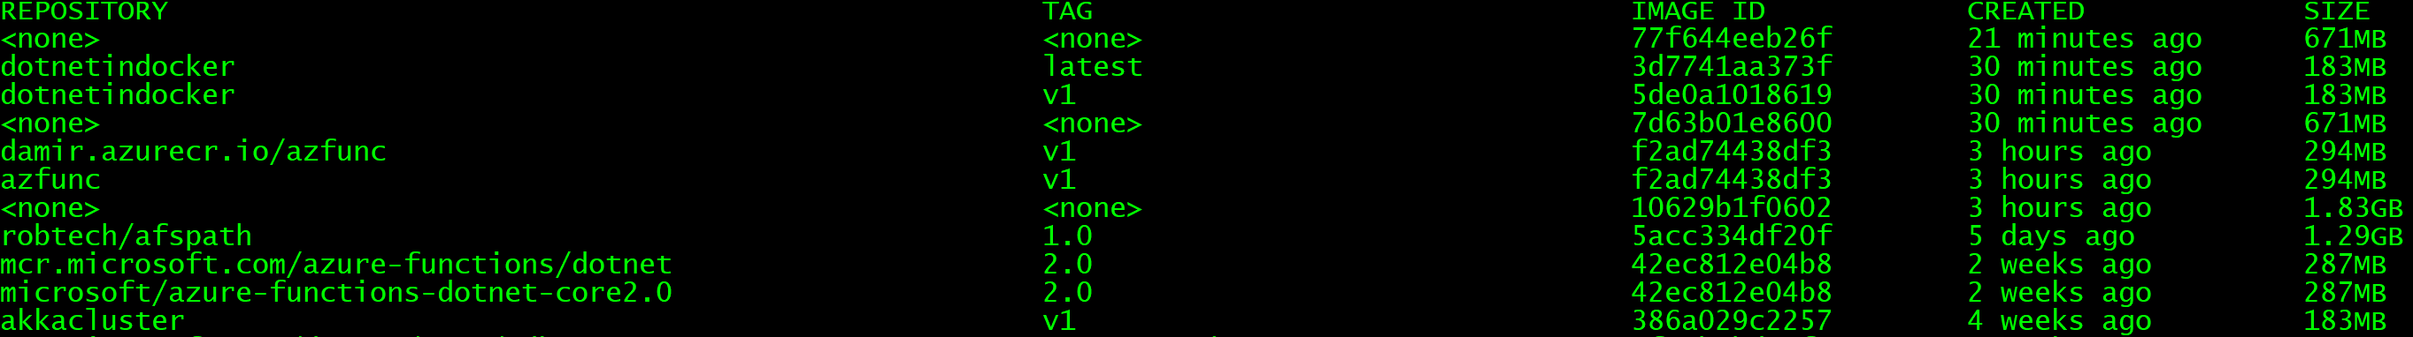
Docker Images
# List images
> docker images
# Remove dangling (<none>) images
> docker rmi $(docker images --quiet --filter "dangling=true")

Slide 25
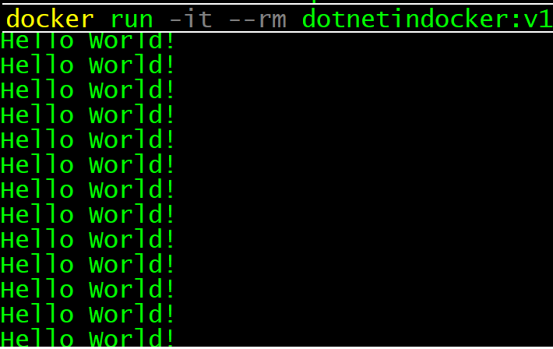
Run application
> docker run -it --rm YOURIMAGENAME:v1
>docker ps
>docker logs --follow 94615e1c7cc1

Slide 26
Create image from ASP.NET Core application
Follow same steps described on previous slides.

Slide 27
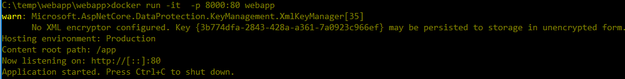
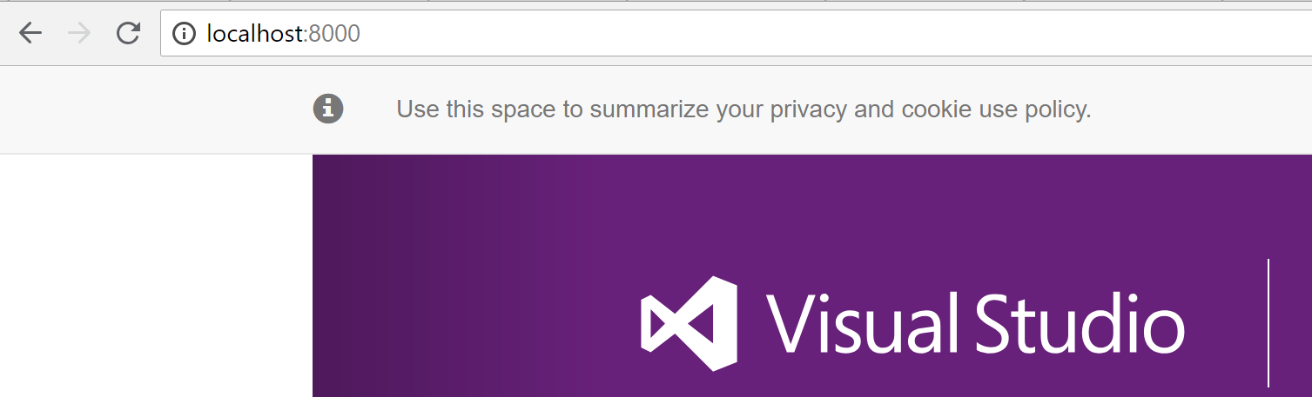
Run web application
Build image
# Build image
> docker build -t aspnetapp .
# Build image
> docker run -it --rm -p 8000:80 aspnetapp
Run container (application)
Navigate to application)
# See what is inside
docker run -it --rm --entrypoint /bin/bash 08b4553a412b

Slide 28
Azure Container Registry

Slide 29
Azure CLI Login
> az login
Start browser, navigate to this address and enterthe code.
Close browser and wait few seconds
>az account list
List all your subscriptions.
Just, as a test

Slide 30
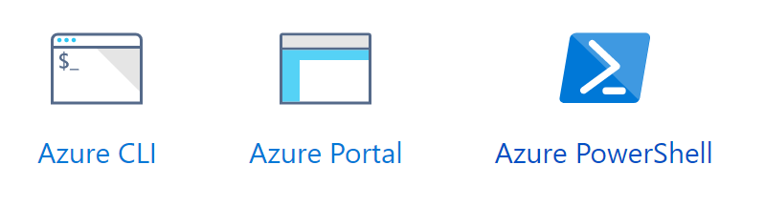
How to create container registry?
>az group create --name RG-REGISTRY --location westeurope
>az acr create --resource-group RG-REGISTRY --name somename --sku Basic
>az group delete --name RG-REGISTRY
https://docs.microsoft.com/en-us/azure/container-registry

Slide 31
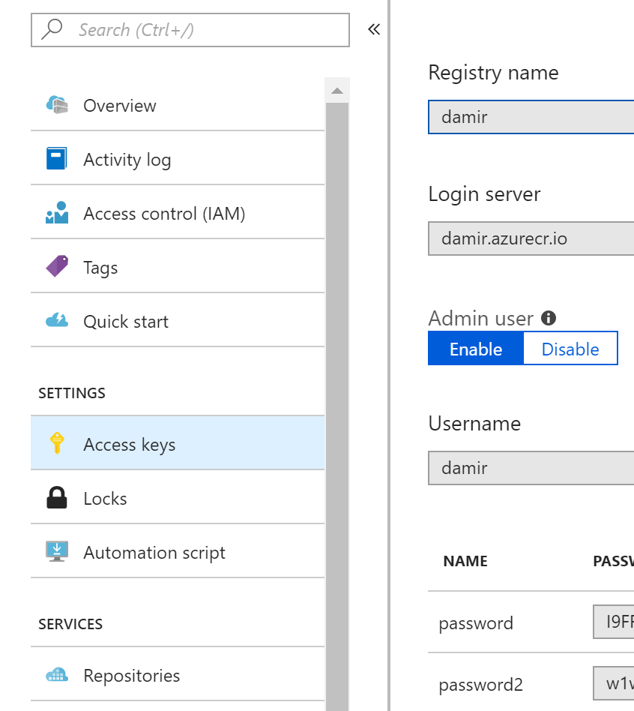
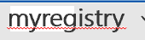
Enable Admin Access and login
With this we can access it from i.e.: command line
myregistry
myregistry
> docker login -u myregistry -p PWD myregistry.azurecr.io

Slide 32
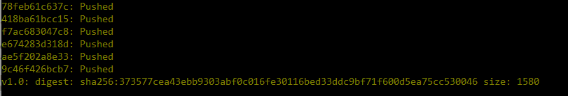
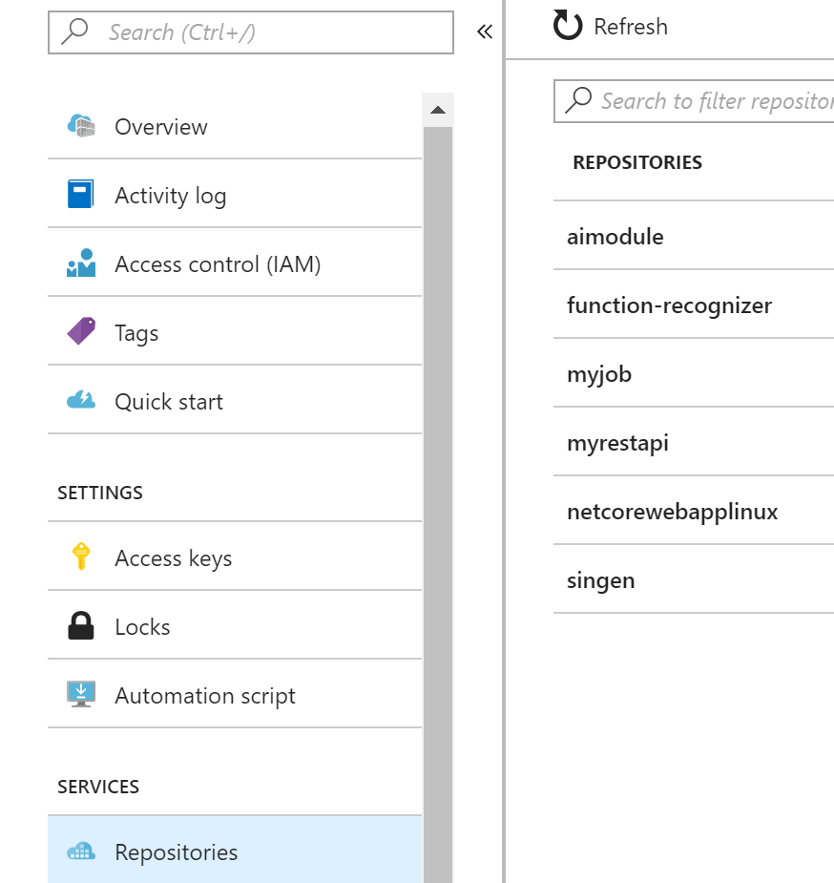
Publishing image to registry
Prepares image for push
> docker tag aspnetapp damir.azurecr.io/aspnetapp:v1.0
> Docker push damir.azurecr.io/aspnetapp:v1.0
Pushes (uploads) image to registry
After publish, repository can be viewed in portal

Slide 33
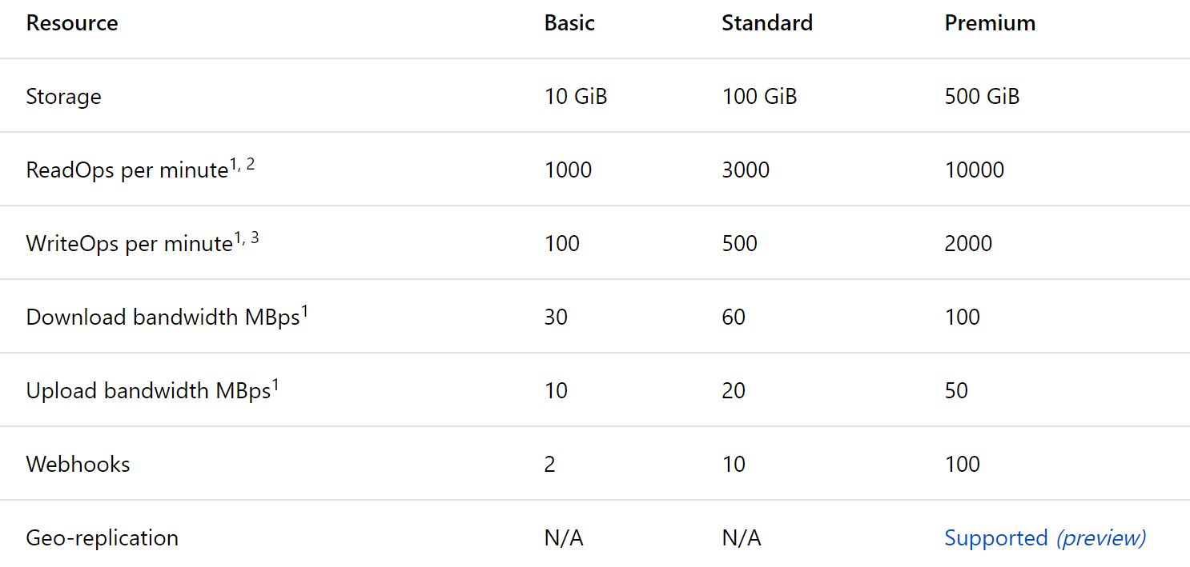
Features and SKUs

Slide 34
Pricing per day / month
5
20

Slide 35
Azure Container Instances

Slide 36



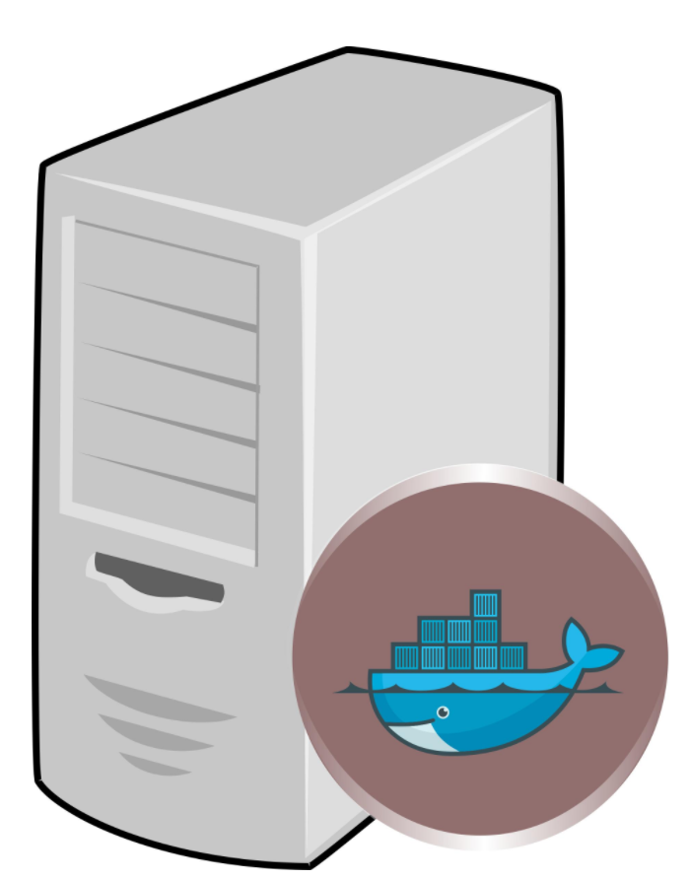

ACI is a host for docker containers
myreg.azurecr.io/myapp1
myreg.azurecr.io/myapp2
myreg.azurecr.io/myapp3
hub.docker.com/r/myreg/myapp1

Slide 37
How to create container instance?
az group create --name RG-ACI --location westeurope
az container create --resource-group RG-ACI
--name myservice1
--image damir.azurecr.io/mywebapi:latest
--ip-address public --ports 80
--os-type windows
--registry-login-server damir.azurecr.io
--registry-username username --registry-password ***
az container show --resource-group RG-ACI --name myservice1 --query "{FQDN:ipAddress.fqdn,ProvisioningState:provisioningState}" --out table
az container show --resource-group RG-ACI --name myservice1
Notes:
az group create --name RG-DEMO --location westeurope
az container create --resource-group RG-DEMO --name myservice1 --image damir.azurecr.io/webapp:v1 --ip-address public --ports 80 --os-type linux --registry-login-server damir.azurecr.io --registry-username damir --registry-password ***
az container create --resource-group RG-DEMO --name dockerdemo2 --image damir.azurecr.io/dockerconsole:v3 --ip-address public --ports 80 --os-type linux --registry-login-server damir.azurecr.io --registry-username damir --registry-password “***" -e SbConnStr="Endpoint=sb://bastasample.servicebus.windows.net/;SharedAccessKeyName=demo;SharedAccessKey=***"

Slide 38
Hosting ASP.NET in Linux Docker
var app = builder.Build();
//
// Required for Linux on Azure or any other configuration with the proxy or LoadBalancer in front of the application.
var forwardOptions = new ForwardedHeadersOptions
{
ForwardedHeaders = ForwardedHeaders.XForwardedFor | ForwardedHeaders.XForwardedProto | ForwardedHeaders.XForwardedHost,
AllowedHosts = new List<string>() { "*"},
RequireHeaderSymmetry = false
};
forwardOptions.KnownNetworks.Clear();
forwardOptions.KnownProxies.Clear();
app.UseForwardedHeaders(forwardOptions);

Slide 39
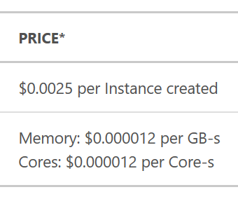
Azure container instances pricing
EXAMPLE: $11.85
You create a container instance with a 1 core, 2 GB configuration 50 times daily during a month (30 days).
The container duration of each instance is 2 minutes and 30 seconds.

Slide 40
Azure Container Service (AKS)

Slide 41
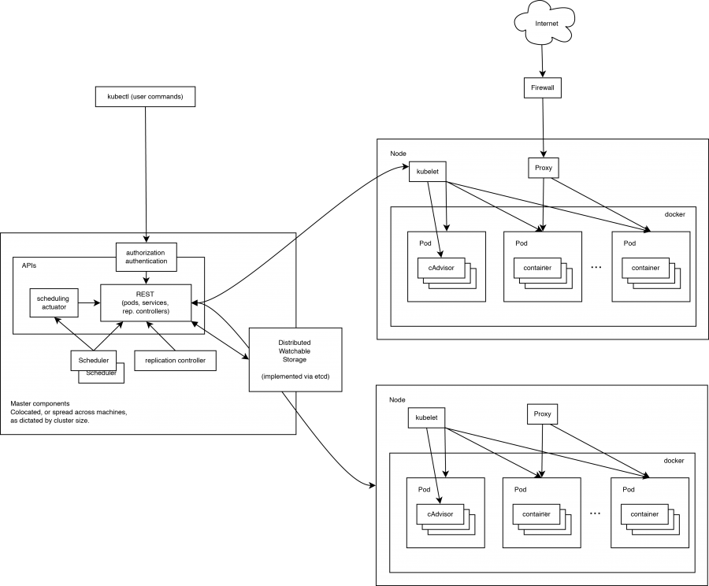
Kubernetes Cluster

Slide 42
K8 abbreviation
KUBERNETES => (K – eight characters – S) => K8S=>K8
WASGIBTES => (S – eight characters – a) => W7S=>W7

Slide 43
Kubernetes on Azure
Managed Kubernetes Cluster in Azure
You don’t deal with infrastructure
No maintenance of VM
No maintenance of Cluster
You pay for consumption

Slide 44
Cluster provisioning
az group create --name myResourceGroup --location westeurope
az aks create --resource-group myResourceGroup --name myAKSCluster --node-count 1 --generate-ssh-keys
Continue here: https://docs.microsoft.com/en-us/azure/aks/kubernetes-walkthrough
kubectl create -f mywebapi-deployment.yaml --validate=false
az aks browse -n myKubeCluster -g RG-KUBE
kubectl delete -f mywebapi-deployment.yaml
https://docs.microsoft.com/en-us/azure/aks/

Slide 45
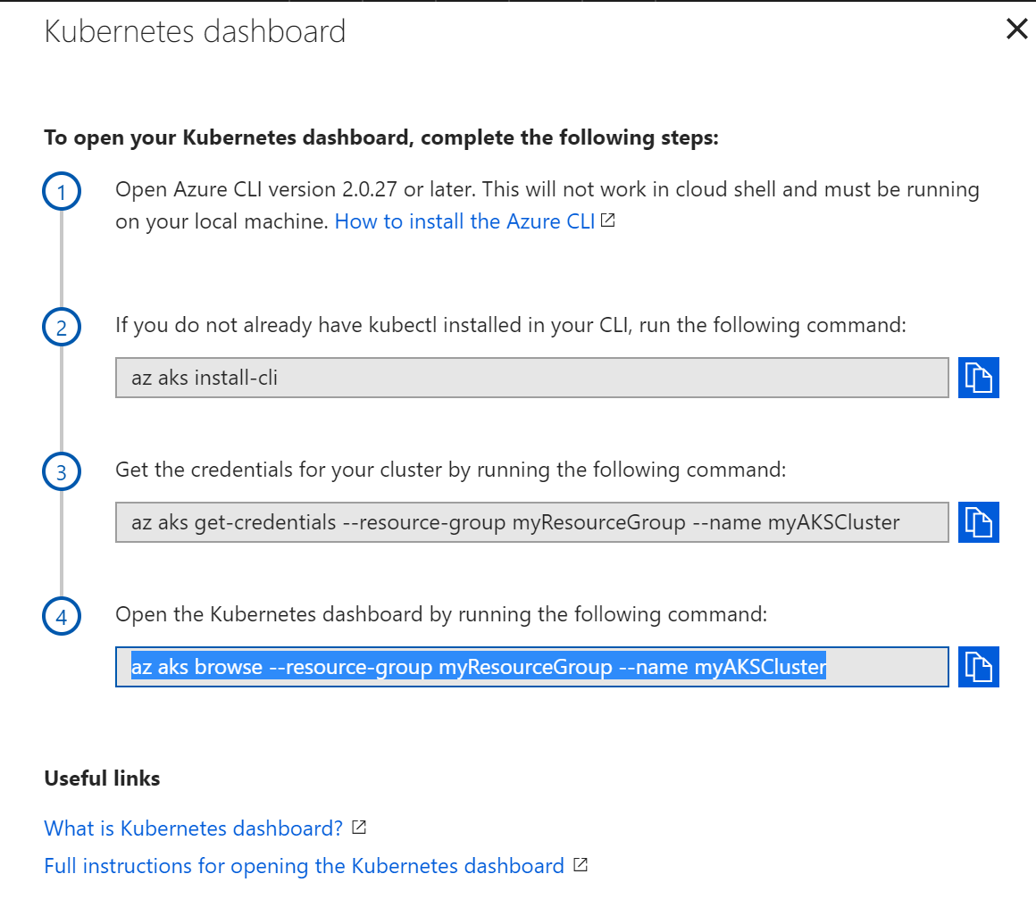
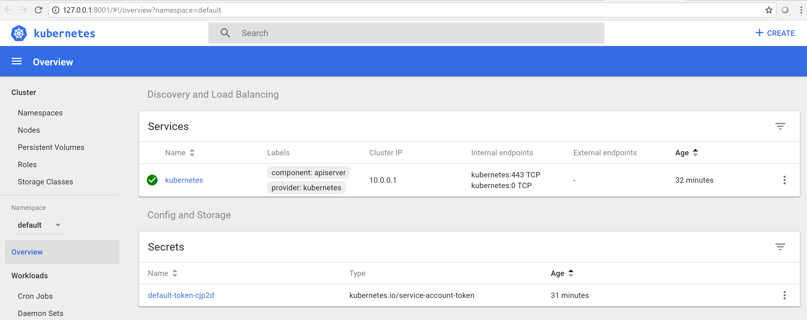
Kubernetes Dashboard

Slide 46
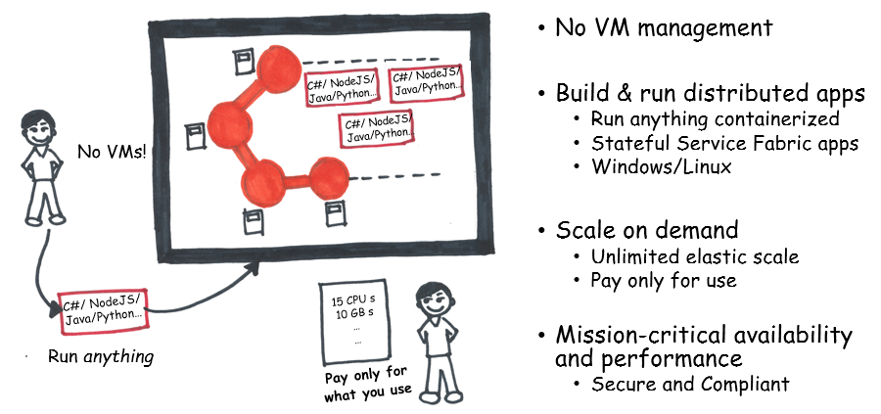
Service Fabric
Microsoft orchestrator is Service Fabric
Isolation on process level
Isolation with docker container

Slide 47
Azure Container Apps
App-centric service, empowering developers to focus on DEVELOPMENT rather than on INFRASTRUCTURE

Slide 48
Azure Container Apps
Built on the foundation of open-source technology
Using KEDA, DAPR and more.
Deploy to Azure Container Apps using Visual Studio | Microsoft Learn
Azure Container Apps documentation | Microsoft Learn

Slide 49
Container facts
Virtual machines (OS virtualization)
You can always do it, but it should not be your first choice.
Containers (Application Isolation)
Still too much infrastructure
Helpful for lift-and-shift
Good approach for microservices, deployment and isolation
Supported on on-prem and in every cloud
Can help to avoid vendor-lock-in
App Service (Special Container for WebApps)
Easier and more modern
Supported on Azure only
It can orchestrate docker containers
Serverless
Most simple, most modern and cheapest option
But it is a container for function and not for application
Not compatible across clouds

Slide 50
Recap
.NET Core runs on Windows and Linux in Docker
Azure Container Registry is a place where to store your containers
Azure Container Instances are easiest way to run containers
Azure Container Service (AKS) is fully managed Kubernetes
Service Fabric is MS orchestrator.
AppService supports docker too.
There are better ways to deploy applications, but containers seems to be most flexible choice at the moment

Slide 51
Why this all might be helpful?
Container
The most common approach to run the application
On-Prem and in every cloud.

Slide 52
Don’t forget
Lift-and-Shift
Same application can run on-prem and in every cloud.To avoid lock-down to vendor.
Vendor Lock-In
You can change cloud or combine clouds
But
Containers are popular, but not necessarily most innovative and efficient way to build software

Slide 53
Thank_You ☺
T7☺
https://damirdobric.me

Slide 54
Thank You

